Slide 1
Privacy laws, FDA Regulations, and Evaluation pertaining to software
BDK03-3 | Ethical Issues in Big Data
Melissa Haendel, PhD | Oregon Health & Science University

Slide 2
Privacy and Security

Slide 3
Privacy and Security
Health Information Privacy – the right of individuals to control the circumstances in which personally identifiable data are collected, used, and transmitted.
Security – guarding against unauthorized use practices, policies, and procedures used to protect data systems against unwarranted disclosure, modification, or distribution and to safeguard the system itself. Examples: encryption, sign-on security codes, audit trails
Sound familiar?
Autonomy: right to privacy, individual freedom, informed consent
Veracity: Telling the truth, keeping promises

Slide 4

Legal right to privacy
Federal Laws
HIPAA Privacy Rules
Privacy Act 1974
State Laws
Extra confidentiality for certain conditions

Slide 5
Privacy Act of 1974
To restrict disclosure of personally identifiable records maintained by agencies.
To grant individuals increased rights of access to agency records maintained on themselves.
To grant individuals the right to seek amendment of agency records maintained on themselves upon a showing that the records are not accurate, relevant, timely, or complete.
To establish a code of "fair information practices“ which requires agencies to comply with statutory norms for collection, maintenance, and dissemination of records.

Slide 6
HIPAA
Health Insurance Portability & Accountability Act (1996)
Protection for the privacy of Protected Health Information
Protection for the security of Protected Health Information
Standardization of electronic data interchange in health care transactions

Slide 7
Privacy is NOT the same as security
Need to define authorized access
You can have privacy breaches with secure technology

Slide 8
Who is an authorized user?
Individual Patient
Family Member / Caregiver?
Personal Physician
(Nurses? Other physicians? Medical Assistants?)
Payer? Health Plan? Government?
Employer?

Slide 9
Follow the data
Hospital
Outpatient Clinics
Patients’ Homes
Pharmacy
Outsourced Services
Home Health
What are the risks?

Slide 10
Public access to data
Are there cases when it is important to have public access to personal health data?
Public health – surveillance, epidemiological investigations, population-based interventions
Research
Quality assurance/monitoring fraud/abuse

Slide 11
Devices

Slide 12
FDA Regulations
Mission: To promote and protect the health of the public by ensuring the safety (and effectiveness) of:
Food (except meat & poultry)
Drugs (prescription & non prescription)
Medical devices
Radiation emitting products
Animal feed, veterinary drugs and devices
Vaccines, transplant tissues, blood products
Cosmetics (except soap & shampoo)

Slide 13

Devices are diverse
stethoscope
artificial heart valve
artificial joints
blood pressure cuff
monitoring instruments
Test strips
Insert a compelling, copyright cleared photos here!

Slide 14
Three classes of devices
Class I
Safety & effectiveness well established
Subject only to general controls (register, list)
Examples: bandages, scalpels
Class II
Moderate risk
Need special controls (guidance, postmarket surveillance, labeling, preclinical testing)
Examples: wheelchairs, contact lenses
Class III
High risk, life-sustaining, risk of illness or injury
Examples: heart valves, pacemakers

Slide 15
What about medical software?
Regulated:
Software that is actually a part of the medical device itself
Software that is an accessory to a medical device
Software that itself is a medical device
Software as part of the production or quality system
Not Regulated:
When there’s competent human intervention
General purpose systems (PCs, databases)
Teaching, non-clinical research systems
Expert systems / decision support that allows “competent human intervention” before an impact on human life would occur

Slide 16
There have been problems…
Therac-25- radiation therapy machine
Pacemakers
Bloodbank software

Slide 17
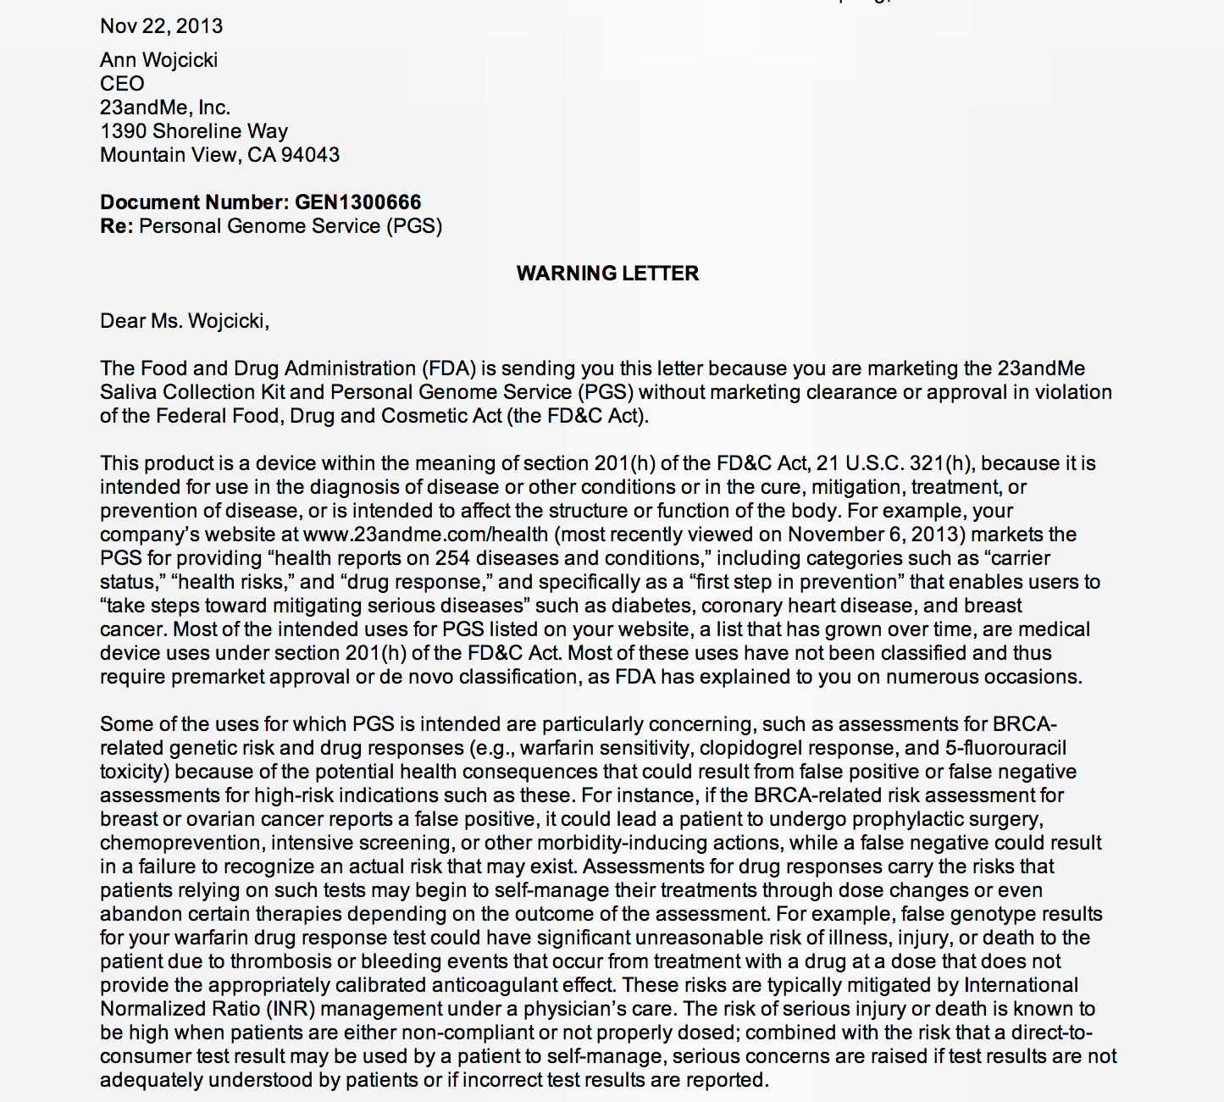
23 and me
Saliva Collection Kit and Personal Genome Service (PGS)

Slide 18
Bringing a device to market
New devices need pre-market approval where the manufacturer shows safety and effectiveness
Devices that are substantially equivalent to something already on the market may file a 501(k) notification and ask the FDA to determine if it has the:
Same intended use, and
Same technological characteristics as the preexisting device, or
Equal safety and effectiveness

Slide 19
FDA Enforcement
Alert health professionals / consumers
Require warnings or relabeling
Withdraw the Investigational Device Exemption
Disqualify the researchers
Recall the devices
Seize the device
Issue an injunction
Civil penalties
Criminal prosecution

Slide 20
FDA Guidelines
Current Good Manufacturing Practice
General Principles of Software Validation
Industry Guidance for the Content of Pre-market Submission for Software Contained in Medical Devices

Slide 21
FDA Regulations
820.30 Design Control
820.30(a) General
(1) Each manufacturer of any class III or class II
device, and the class I devices listed in paragraph
(a)(2) of this section, shall: establish and maintain
procedures to control the design of the device in
order to ensure that specified design requirements
are met.
(2) The following class I devices are subject to design
controls:
(i) Devices automated with computer software

Slide 22
FDA Regulations
820.30 Design Control
…..
3.3 Software Is Different From Hardware
“Because of its complexity, the development process for
software should be even more tightly controlled than
for hardware, in order to prevent problems that
cannot be easily detected later in the development
process”.
“……. software engineering needs an even greater level
of managerial scrutiny and control than does
hardware engineering”.

Slide 23
FDA Device Recall Statistics
1992-1998

Slide 24
Device Recalls 3140
Total software-related recalls 242
Software recalls due to changes 192
(defects introduced when changes were
made to the software after its initial
production and distribution)
Since 2013, >500 devices with the word “software”
in the device label have been recalled

Slide 25
ISO 9000
International Organization on Standards
Over 200 countries
Voluntary
ISO 9000 – quality management
Customers expect it; competitors use it

Slide 26
Safety Standards
ISO/IEC Standards
60601-1: Medical Electrical Equipment
60601-1-4: Programmable Electronic Medical Systems
14971: Risk Management for Medical Devices
IEEE Standards 1012 & 1059
Software Verification & Validation

Slide 27
Evaluating Medical Information Systems: Ethical considerations
How much evaluation is enough?
How much time and money to spend?
Who should be doing the evaluation?
How to standardize the criteria/data used in the evaluations?

Slide 28
Thank you
This course was made possible under a grant from the NIH (# 1R25GM114820-01)

